Slide 1
3D Transformations
UNIT 3

Slide 2
3D Transformations
3D Transformations take place in a three dimensional plane.
3D Transformations are important and a bit more complex than 2D Transformations.
Transformations are helpful in changing the position, size, orientation, shape etc of the object.
Translation
Rotation
Reflection
Scaling
Shearing

Slide 3
Translation
3D Translation is a process of moving an object from one position to another in a three dimensional plane.
Translation is done using translation vectors. There are three vectors in 3D instead of two.
These vectors are in x, y, and z directions:
Translation in the x-direction is represented using T_{x}.
The translation is y-direction is represented using T_{y}.
The translation in the z- direction is represented using T_{z}.

Slide 4
Let-
Initial coordinates of the object O = (X_{old}, Y_{old}, Z_{old})
New coordinates of the object O after translation = (X_{new}, Y_{new}, Z_{old})
Translation vector or Shift vector = (T_{x}, T_{y}, T_{z})
Given a Translation vector (T_{x}, T_{y}, T_{z})-
T_{x} defines the distance the X_{old} coordinate has to be moved.
T_{y} defines the distance the Y_{old} coordinate has to be moved.
T_{z} defines the distance the Z_{old} coordinate has to be moved.

Slide 5
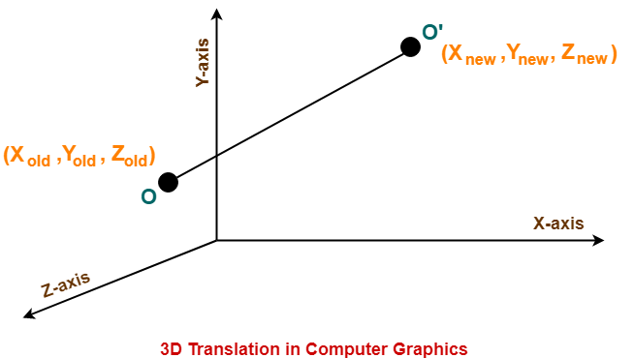
This translation is achieved by adding the translation coordinates to the old coordinates of the object as-
X_{new} = X_{old} + T_{x} (This denotes translation towards X axis)
Y_{new} = Y_{old} + T_{y} (This denotes translation towards Y axis)
Z_{new} = Z_{old} + T_{z} (This denotes translation towards Z axis)

Slide 6
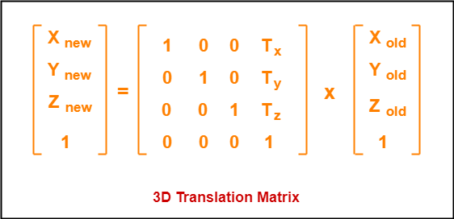
MATRIX MUL

Slide 7
Rotation
It is moving of an object about an angle. Movement can be anticlockwise or clockwise.
3D rotation is complex as compared to the 2D rotation.
For 2D we describe the angle of rotation, but for a 3D angle of rotation and axis of rotation are required. The axis can be either x or y or z.
3D Rotation is a process of rotating an object with respect to an angle in a three dimensional plane.

Slide 8
Let-
Initial coordinates of the object O = (X_{old}, Y_{old}, Z_{old})
Initial angle of the object O with respect to origin = Φ
Rotation angle = θ
New coordinates of the object O after rotation = (X_{new}, Y_{new}, Z_{new})
In 3 dimensions, there are 3 possible types of rotation-
X-axis Rotation
Y-axis Rotation
Z-axis Rotation

Slide 9

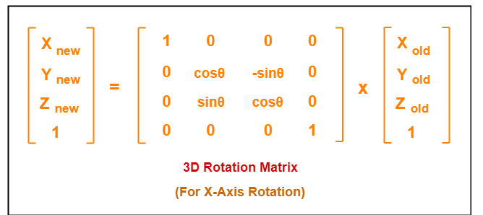
For X-Axis Rotation
This rotation is achieved by using the following rotation equations-
X_{new} = X_{old}
Y_{new} = Y_{old} x cosθ – Z_{old} x sinθ
Z_{new} = Y_{old} x sinθ + Z_{old} x cosθ

Slide 10
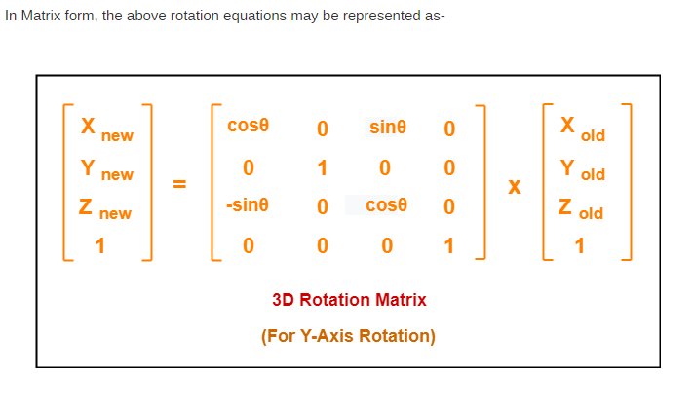
For Y-Axis Rotation
This rotation is achieved by using the following rotation equations-
X_{new} = Z_{old} x sinθ + X_{old} x cosθ
Y_{new} = Y_{old}
Z_{new} = Y_{old} x cosθ – X_{old} x sinθ

Slide 11
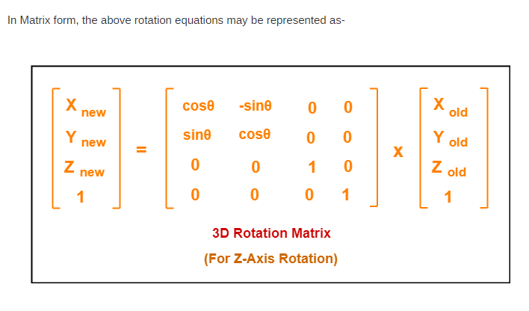
For Z-Axis Rotation-
This rotation is achieved by using the following rotation equations-
X_{new} = X_{old} x cosθ – Y_{old} x sinθ
Y_{new} = X_{old} x sinθ + Y_{old} x cosθ
Z_{new} = Z_{old}

Slide 12
Scaling
Scaling may be used to increase or reduce the size of object.
Scaling subjects the coordinate points of the original object to change.
Scaling factor determines whether the object size is to be increased or reduced.
If scaling factor > 1, then the object size is increased.
If scaling factor < 1, then the object size is reduced.

Slide 13
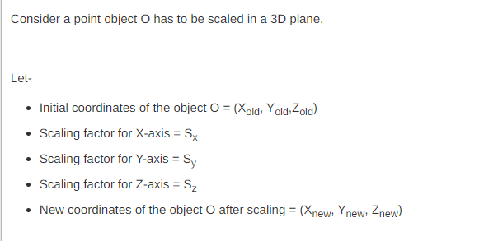
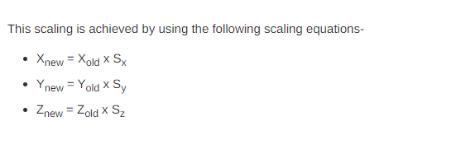

Slide 14
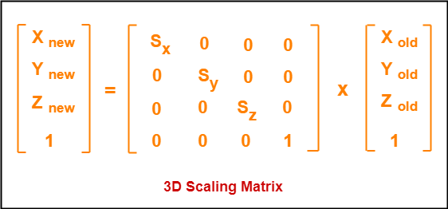
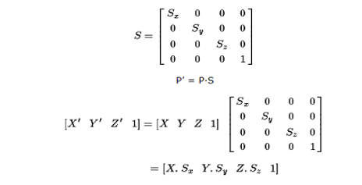

Slide 15
Reflection
It is also called a mirror image of an object. For this reflection axis and reflection of plane is selected.
Three-dimensional reflections are similar to two dimensions. Reflection is 180° about the given axis.
For reflection, plane is selected (xy,xz or yz).
The reflected object is always formed on the other side of mirror.
The size of reflected object is same as the size of original object.

Slide 16


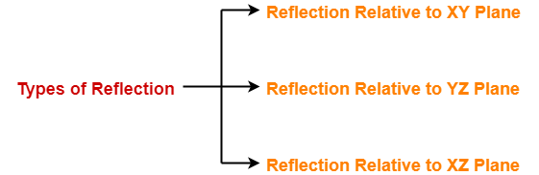

Consider a point object O has to be reflected in a 3D plane.
Let-
Initial coordinates of the object O = (X_{old}, Y_{old}, Z_{old})
New coordinates of the reflected object O after reflection = (X_{new}, Y_{new},Z_{new})

Slide 17
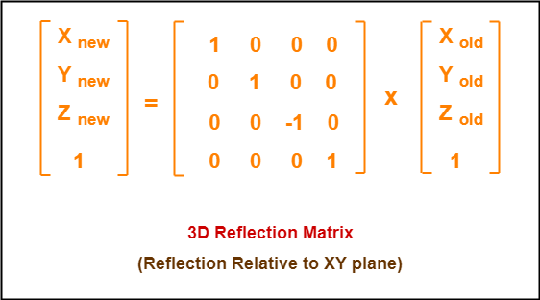
Reflection Relative to XY Plane:
Reflection Relative to XY Plane:
This reflection is achieved by using the following reflection equations-
X’ = X
Y’ = Y
Z’ = -Z
X_{new} = X_{old}
Y_{new} = Y_{old}
Z_{new} = -Z_{old}

Slide 18
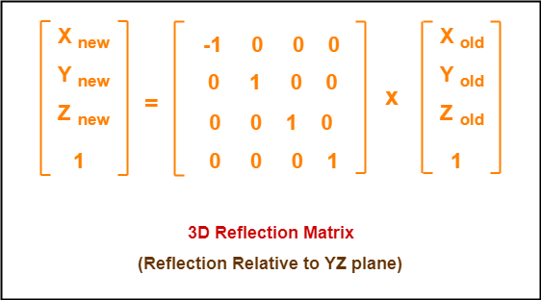
Reflection Relative to YZ Plane
This reflection is achieved by using the following reflection equations-
X’ = -X
Y’ = Y
Z’ = Z
X_{new} = -X_{old}
Y_{new} = Y_{old}
Z_{new} = Z_{old}

Slide 19
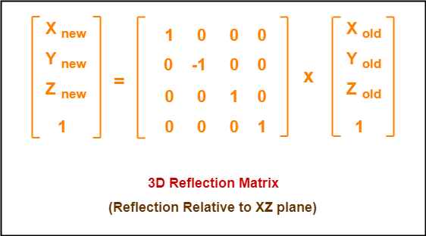
Reflection Relative to XZ Plane
This reflection is achieved by using the following reflection equations-
X’ = X
Y’ = -Y
Z’ = Z
X_{new} = X_{old}
Y_{new} = -Y_{old}
Z_{new} = Z_{old}

Slide 20
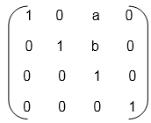
Shearing
It is change in the shape of the object.
It is also called as deformation.
Change can be in the x -direction or y -direction or both directions in case of 2D. If shear occurs in both directions, the object will be distorted. But in 3D shear can occur in three directions.

Slide 21
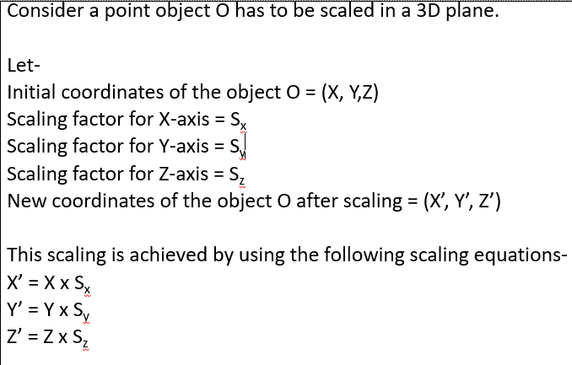

Slide 22
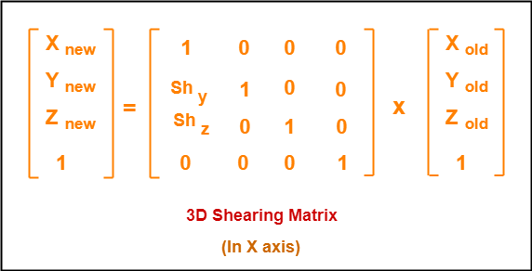
Shearing in X Axis-
Shearing in X axis is achieved by using the following shearing equations-
X_{new} = X_{old}
Y_{new} = Y_{old} + Sh_{y} x X_{old}
Z_{new} = Z_{old} + Sh_{z} x X_{old}

Slide 23
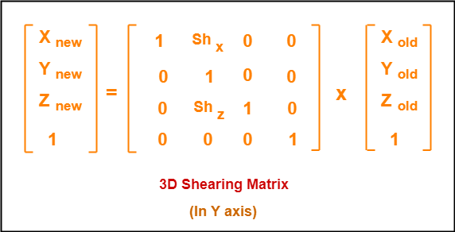
Shearing in Y Axis-
Shearing in Y axis is achieved by using the following shearing equations-
X_{new} = X_{old} + Sh_{x} x Y_{old}
Y_{new} = Y_{old}
Z_{new} = Z_{old} + Sh_{z} x Y_{old}

Slide 24
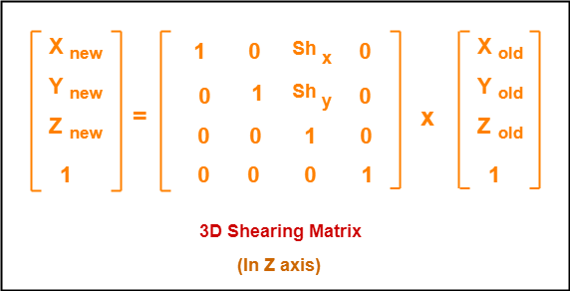
Shearing in Z Axis
Shearing in Z axis is achieved by using the following shearing equations-
X_{new} = X_{old} + Sh_{x} x Z_{old}
Y_{new} = Y_{old} + Sh_{y} x Z_{old}
Z_{new} = Z_{old}

